Slide 1
Efficient coding for general perception
We take natural images from our database, OTF filter them with the right PPD (100) for the camera.
Then we take many random patches and sample their greyscale values, and gradient histograms (gradients are computed using steerable filters, then normalized by local luminance and contrast, i.e. local sd). This gives us CDF’s of these features.
We then pick efficient-coding bins for these features. We adjust the number of bins for each scale. We save these bins.
Texture discrimination: training
We take equal numbers of same and different texture patch pairs from the Brodatz texture set, and apply the OTF filter on them.
For each pair, we compute decision variables for:
Power spectrum
Greyscale histogram (using the efficient coding bins learned from natural images)
Gradient histograms (using efficient-coding bins):
Gradient magnitude hist. at 4 scales
Gradient orientation hist. at 4 scales
Gradient product hist. at 4 scales
Edge contour features:
Number of detected edge pixels
Number of detected edge contours
Contour length distribution
Contour curvature distribution
We combine the gradient magnitude dv’s across the 4 scales into one dv. Same for gradient orientation and gradient product. We save these boundary functions.
We then classify same vs. different using all these dv’s. We save the combined boundary function.
Texture discrimination: testing
Given a pair of texture patches, we load the efficient coding bins and compute the different feature dv’s. Then we load the trained boundary functions, and compute the final decision of same/different.

Slide 3
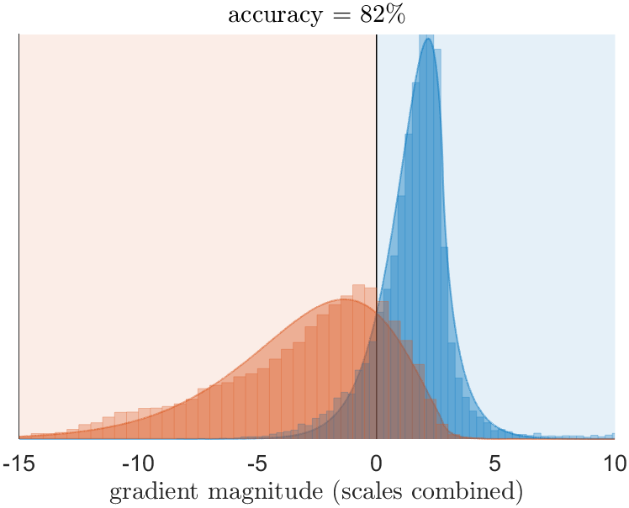
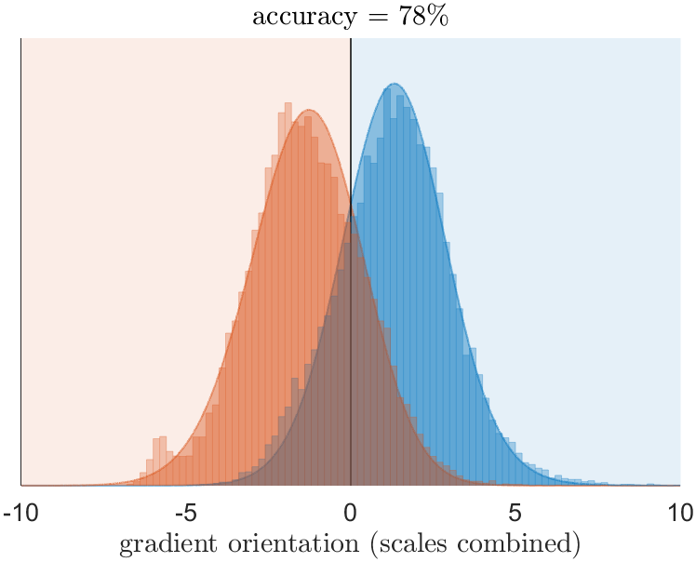
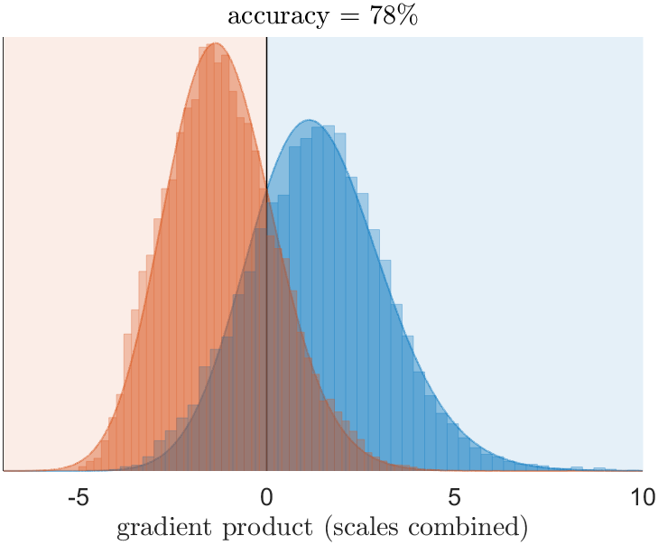
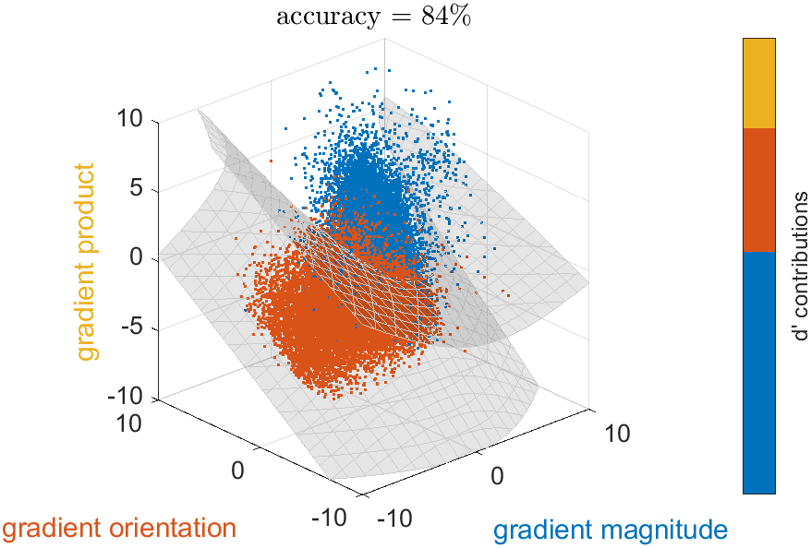

Slide 4
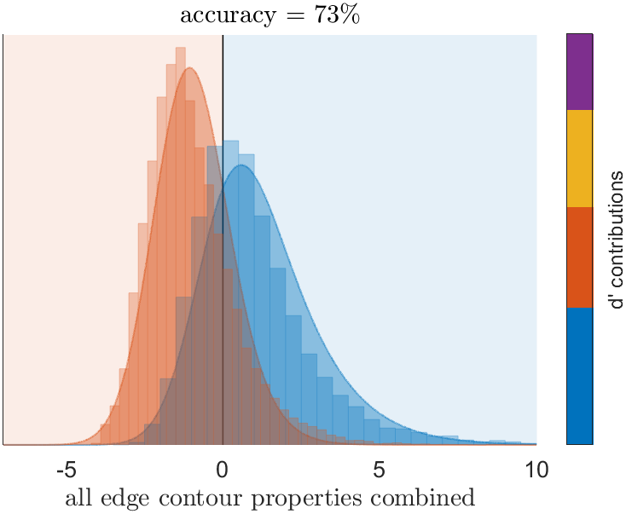
contour curvature distribution
contour length distribution
# of edge contours
# of edge pixels

Slide 5
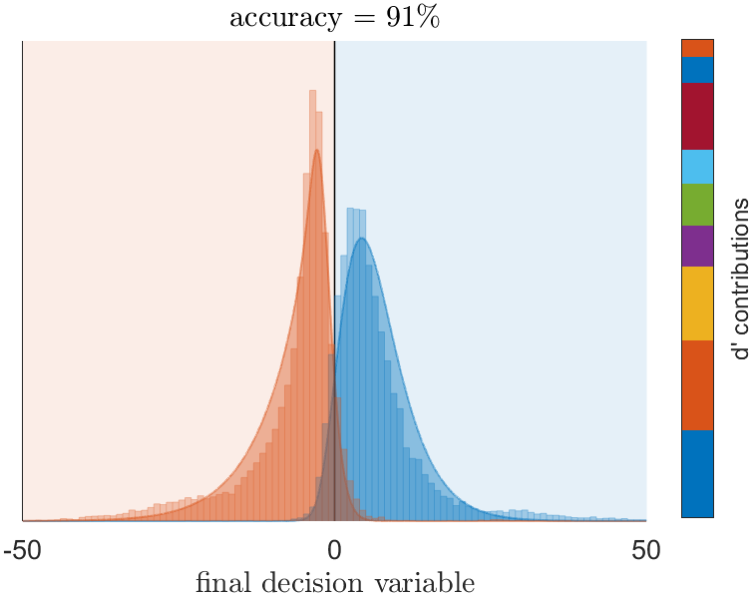
contour curvature distribution
contour length distribution
# of edge contours
# of edge pixels
gradient product histogram
gradient orientation histogram
gradient magnitude histogram
greyscale histogram
power spectrum

